Slide 1



Correlation between media and its features
Ananya Subramaniam

Slide 2


Research Question
Is there is a correlation between the popularity of a show/movie and different factors (genres, runtime, seasons, release year)?
Hypothesis
NO CORRELATION

Slide 3

Data Structuring
id,title,type,description,release_year,age_certification,runtime,genres,production_countries,seasons,imdb_id,imdb_score,imdb_vote,
tmdb_popularity,tmdb_score
ts300399,Five Came Back: The Reference Films,SHOW,"This collection includes 12 World War II-era propaganda films — many of which are graphic and offensive — discussed in the docuseries ""Five Came Back.""",1945,TV-MA,48,['documentation'],['US'],1.0,,,,0.6,
tm84618,Taxi Driver,MOVIE,"A mentally unstable Vietnam War veteran works as a night-time taxi driver in New York City where the perceived decadence and sleaze feed his urge for violent action, attempting to save a preadolescent prostitute in the process.",1976,R,113,"['crime', 'drama']",['US'],,tt0075314,8.3,795222.0,27.612,8.2

Slide 4

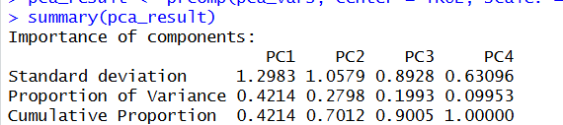
Data Cleanup
PCA
Found PCA for each row using the 4 variables
Added a new column (PC1) as a measurement for popularity
Some rows didn’t have all the values → had to exclude the rows with NA or null values
Divided the data based on low, med and high popularity
Lowest 33% = Low, Med 33% = Medium, Highest 33% = Highest

Slide 5
Data Cleanup
Split File into 2 subsets
One table for TV shows and another for movies
Cleaned up genre column
Genres were stored as a list
Mutated dataset
OG: Taxi Driver → [“crime”, “drama”]
New: 2 lines
Taxi Driver → “crime”
Taxi Driver → “drama”

Slide 6

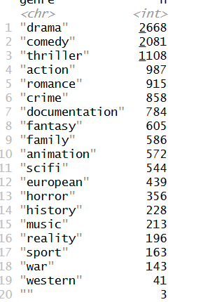
Descriptive Stats
19 Genres

Slide 7
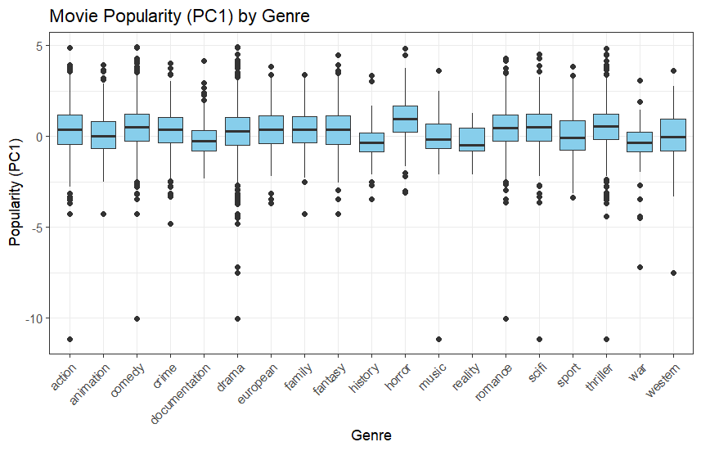
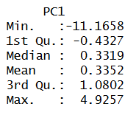
Descriptive Stats
Movies

Slide 8
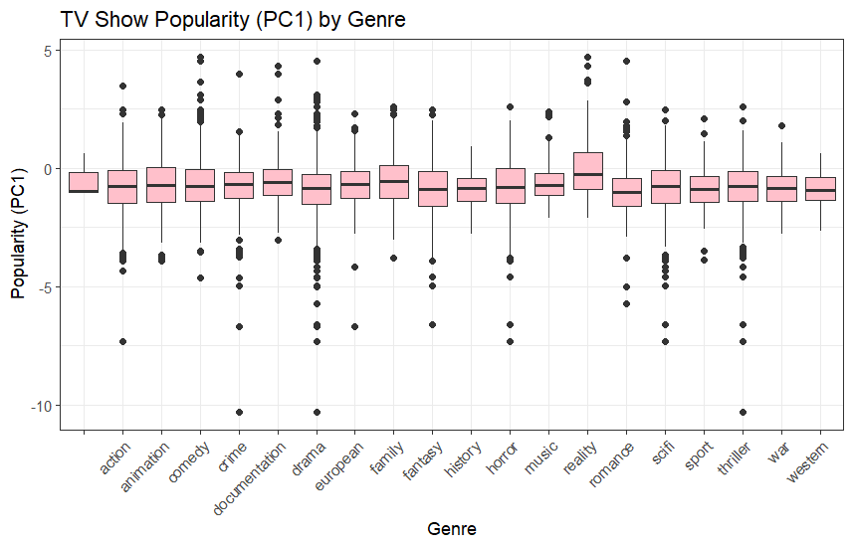
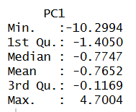
Descriptive Stats
TV Shows

Slide 9
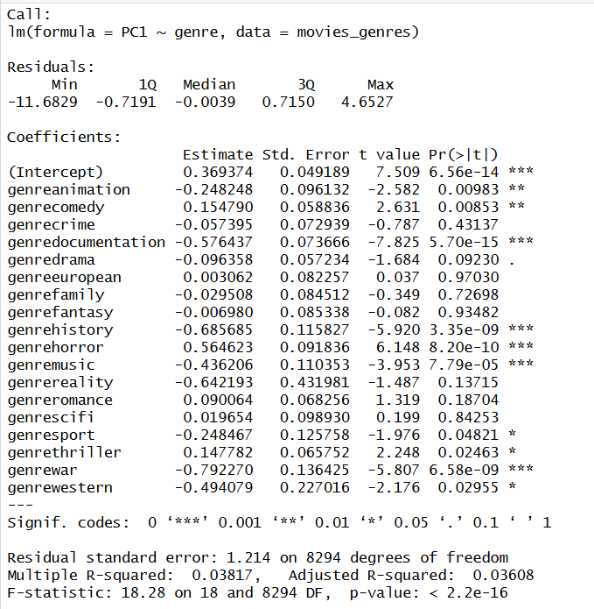
Linear Models
MOVIES
POPULATION ~ GENRE
Genre = categorical
Had to set a baseline (Action)
Coefficient of each genre tells us how much or less popular another genre is compared to Action
R^2 value → 3.6%
Does help in direct comparison between the genre popularities

Slide 10
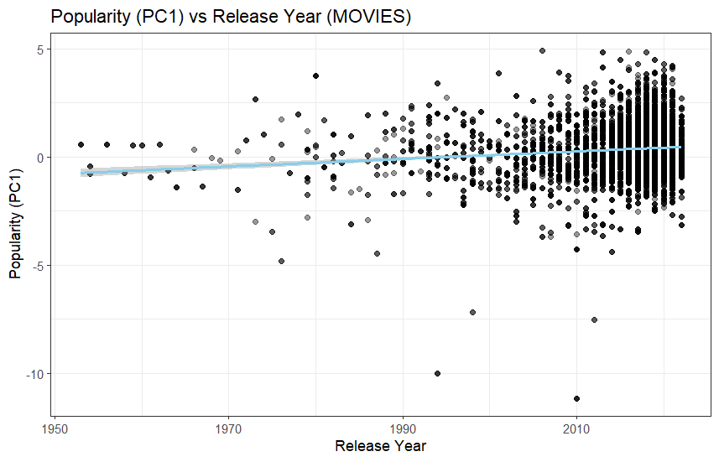
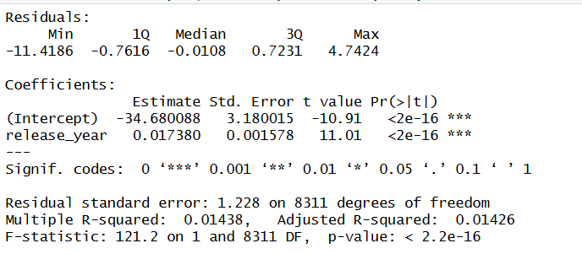
Linear Models
MOVIES
POPULATION ~ RELEASE YEAR
Upward slope → 0.017
2000-2020 → wider spread
R^2 → 1.4%

Slide 11
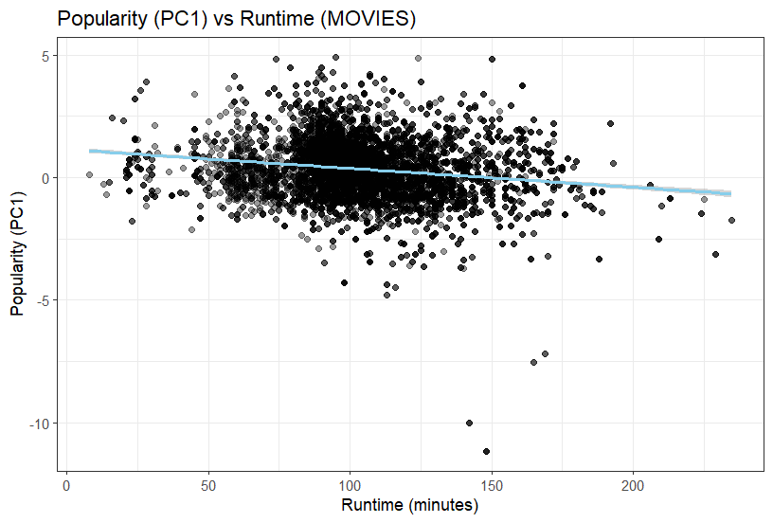
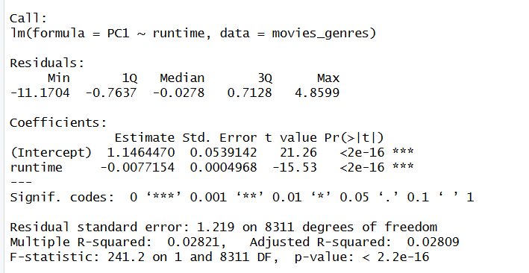
Linear Models
MOVIES
POPULATION ~ RUNTIME
Downward slope → -0.007
+90 mins → decrease by 0.69
Cluster around 80-120 mins
R^2 → 2.8%

Slide 12
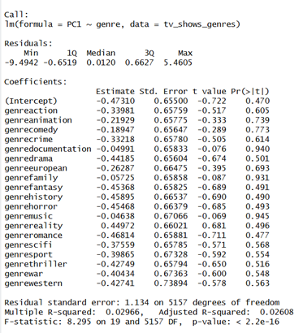
Linear Models
TV SHOWS
POPULATION ~ GENRE
R^2 value → 2.6%
Does help in direct comparison between the genre popularities

Slide 13
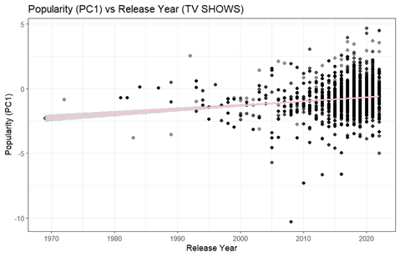
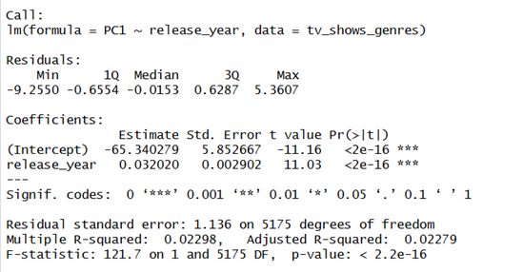
Linear Models
TV SHOWS
POPULATION ~ RELEASE YEAR
Upward slope → 0.03
2000-2020 → wider spread
R^2 → 2.2%

Slide 14
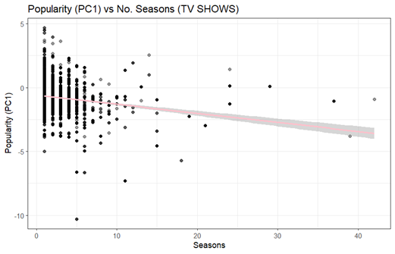
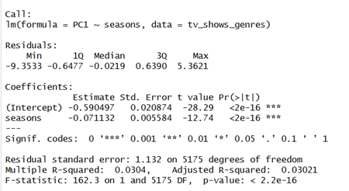
Linear Models
TV SHOWS
POPULATION ~ NO. SEASONS
Downward slope → -0.07
R^2 → 3%

Slide 15
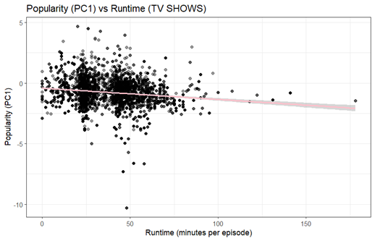
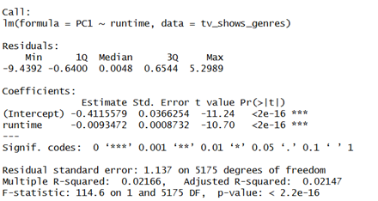
Linear Models
TV SHOWS
POPULATION ~ NO. SEASONS
Downward slope → -0.009
R^2 → 2%

Slide 16
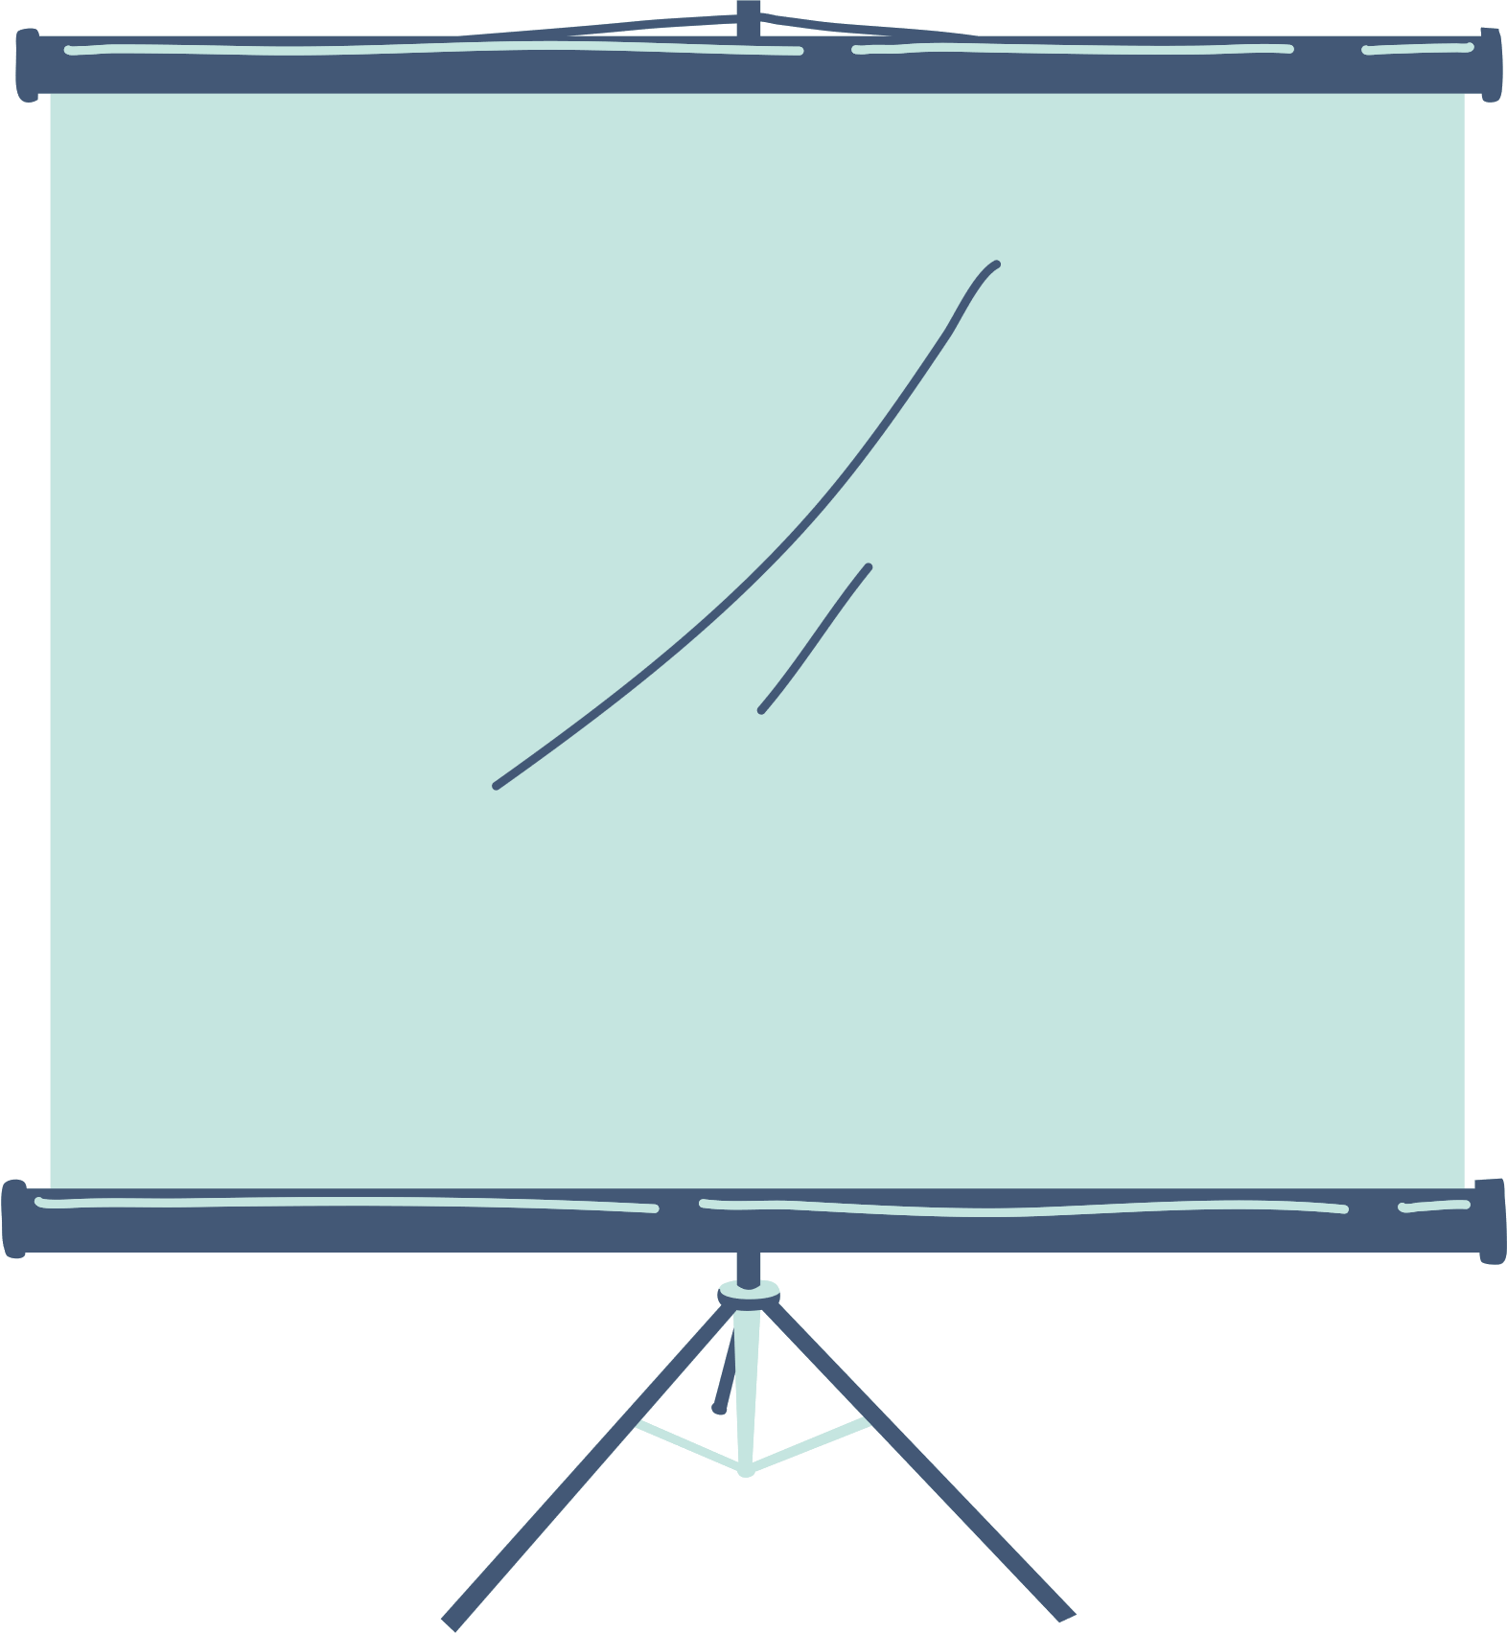
Linear Model Overview
TV Shows and Movies behave similar
Supports overall message of this analysis that there should not be a quantifiable way to determine popularity. Rather, it should be dependent on the work put in by creators and audiences alike.

Slide 17

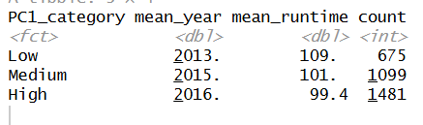
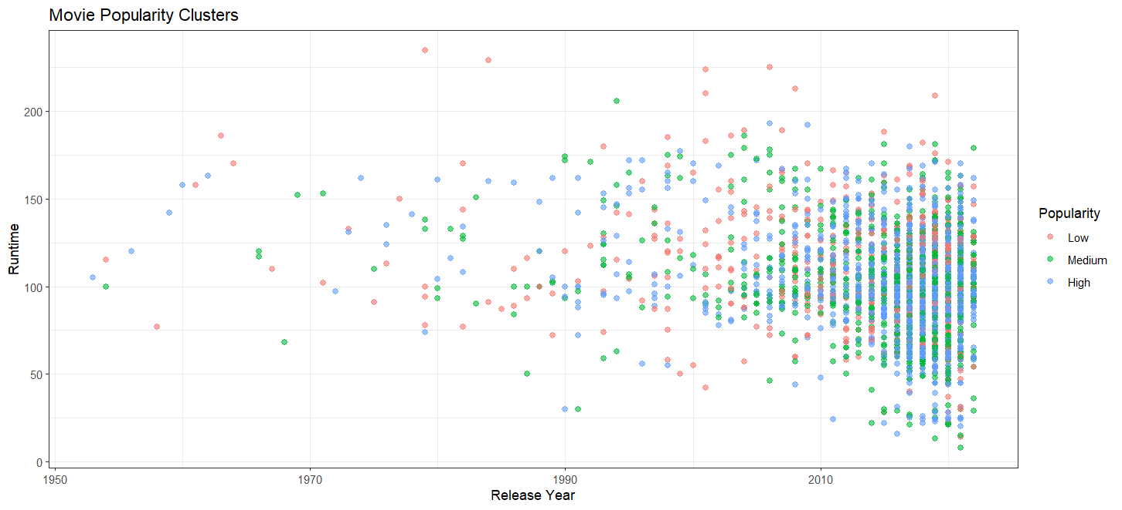
K MEANS CLUSTERING
Movies
High popularity Newer & shorter runtimes

Slide 18
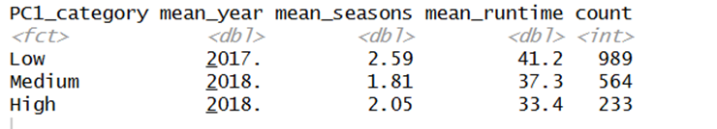
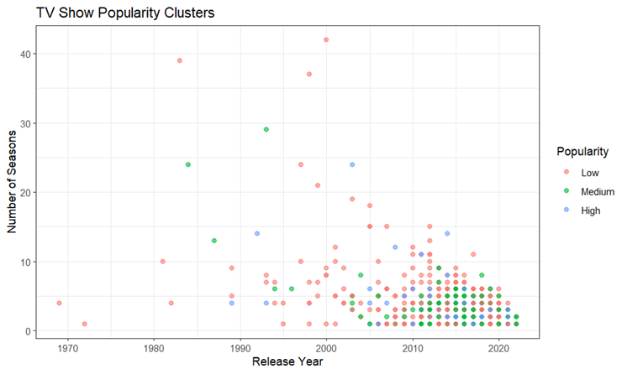
K MEANS CLUSTERING
TV
Shows
High popularity Newer & shorter runtimes
High & Low popularity
~2 seasons

Slide 19

Limitations
1.
3.
Omitted Rows because of PCA
Not all factors are taken into consideration
Delays → Covid-19, Writers strike
Affects release year or seasons of a show
Shows can be cancelled early based on network decisions even if it is popular
2.
4.
Comparing features against revenue would be better for a societal analysis
Could get a better picture about if people are influenced to create certain types of content because of statistics
Netflix Limited Data

Slide 20
Conclusion
Hypothesis was proven → There was no correlation

Slide 21

Takeaway
It is important to emphasize the importance of creating to say something rather than prove statistics. The no correlation output is significant because it means that people are spreading their voice without being constrained with the pressure of guaranteed successes.

Slide 22

Thank you!
Any questions?

